Slide 1


CONNECTTEL
CUSTOMER CHURN DATA ANALYSIS AND PREDICTION
By
Jerry Sunday Odekunle

Slide 2

PROJECT ANALYSIS / GUIDE
Problem definition:
How will the company benefit from your solution?
BENEFIT OF MY SOLUTION
In this data-driven journey, CONNECTTEL engaged us to address a critical challenge faced by the company, a leading telecommunications company: customer churn. Our mission is to harness the power of advanced analytics and Machine Learning to build a robust churn prediction system. By doing so, with the knowledge, we will empower CONNECTTEL to proactively retain customers, foster loyalty, and stay ahead in this fiercely competitive telecom world. Join us as we employ into the world of Supervised Machine Learning Algorithms to help CONNECTTEL secure its future in the digital age and solve their present challenge.

Slide 3
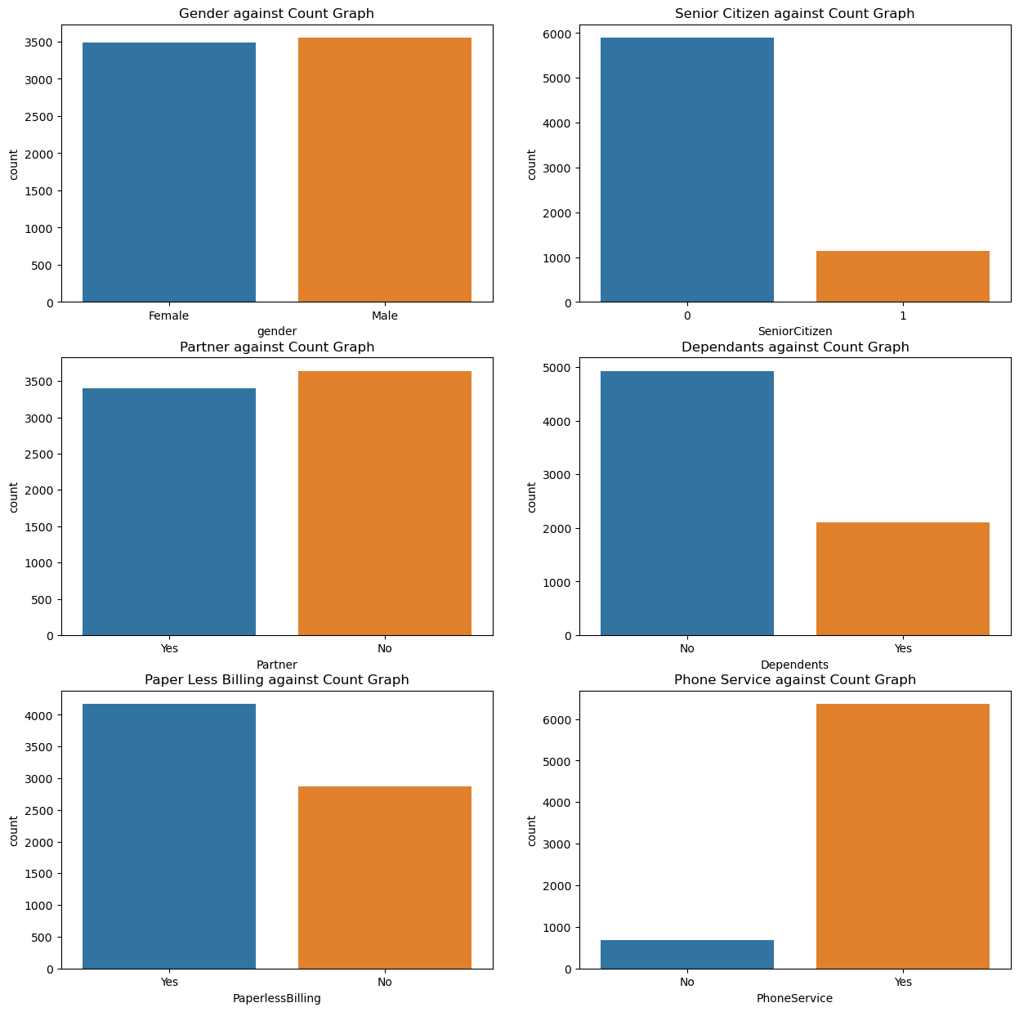
Virtualization In Comparison with Some Features

Slide 4
Virtualization In Comparison with Some Features

Slide 5
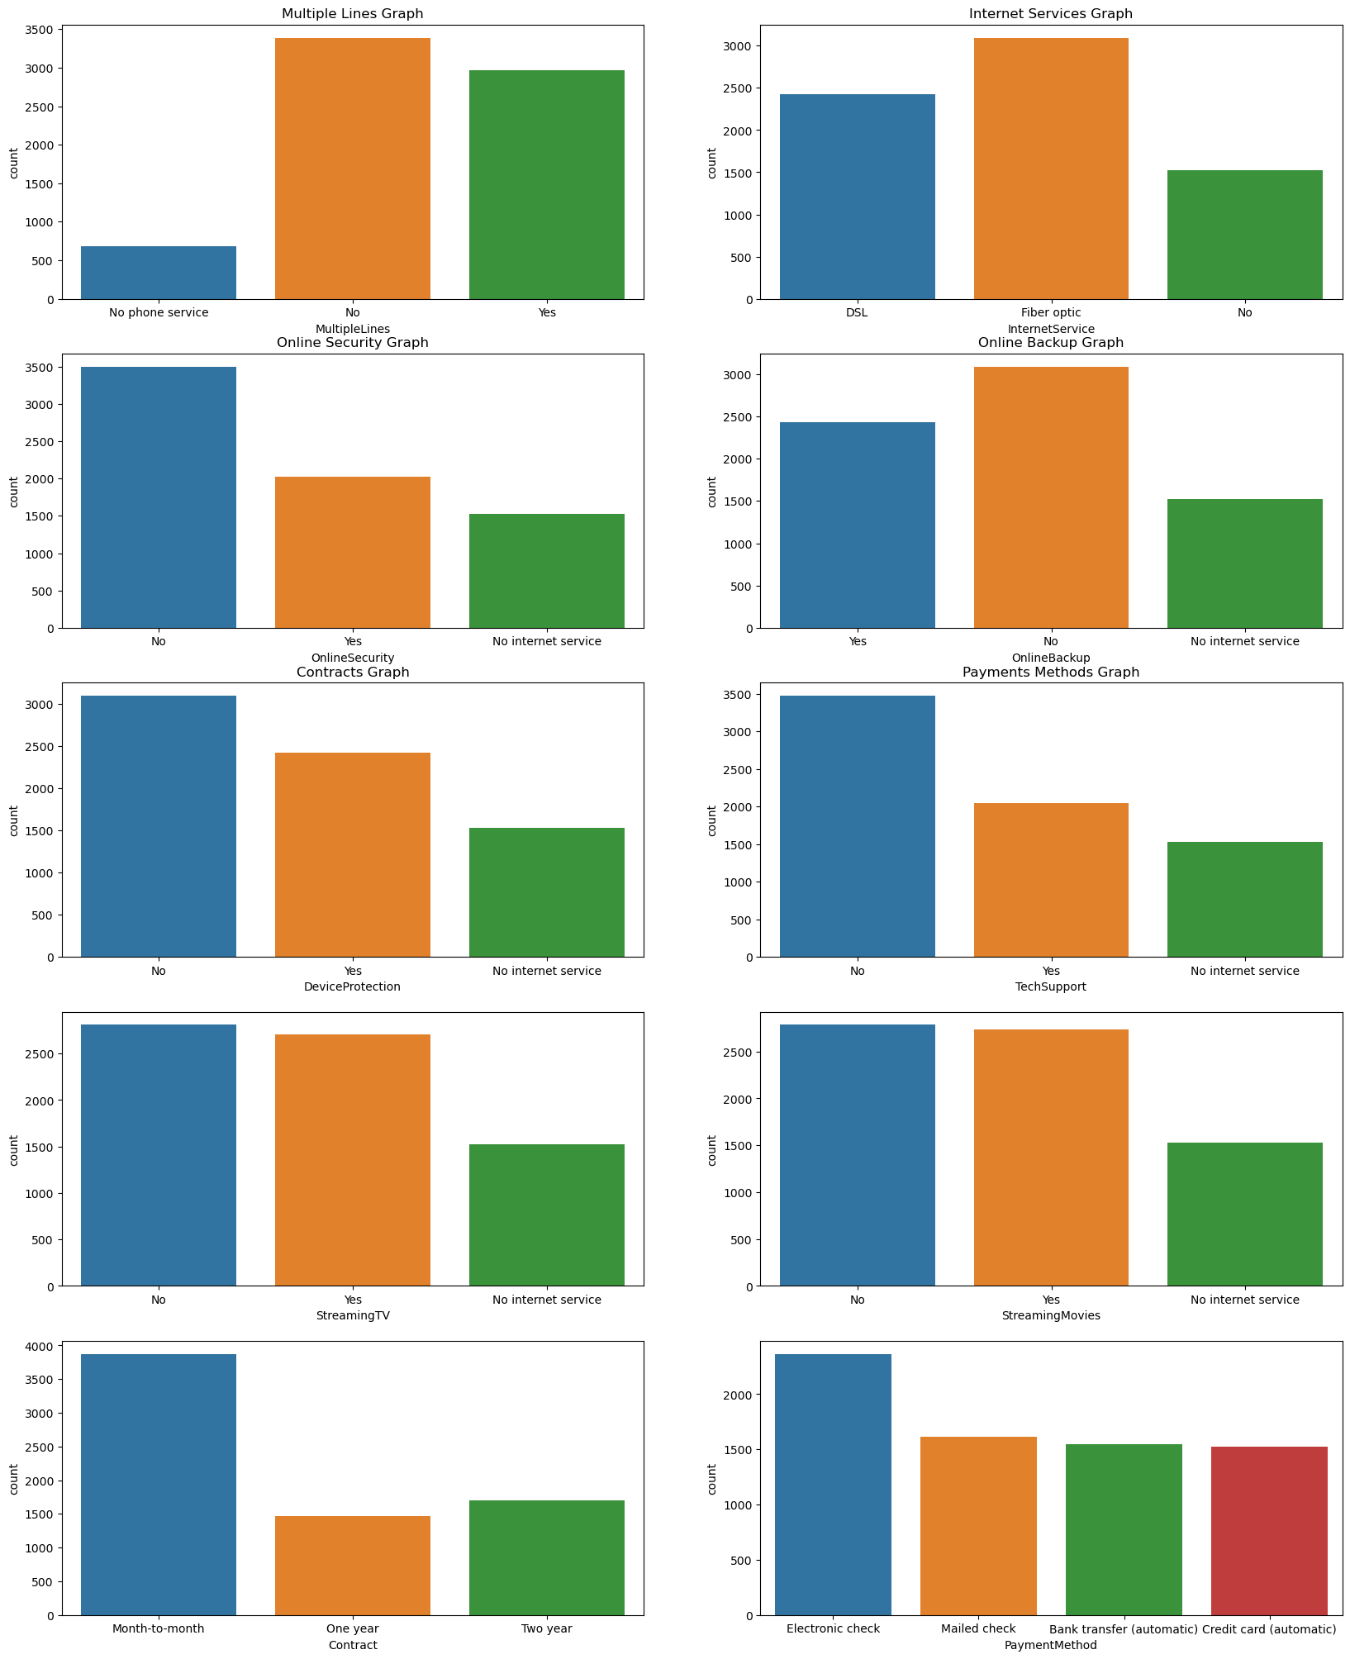
Virtualization In Comparison with Some Features

Slide 6
Virtualization In Comparison with Some Features

Slide 7
Virtualization In Comparison with Some Features

Slide 8
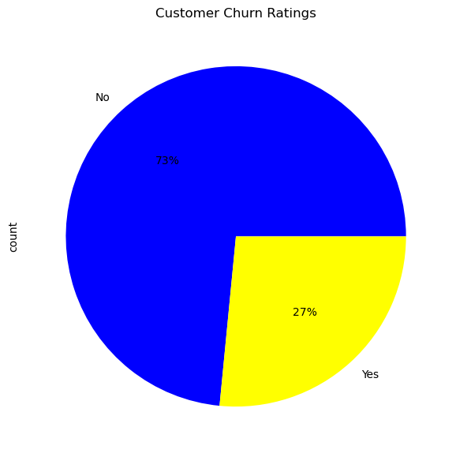
Virtualization In Comparison with Some Features

Slide 9
Model Selection, Training and Validation: Model Evaluation
Accuracy Score
XGB Classifier | SGD Classifier | Logistic Regression | KNeighbors Classifier | Random Forest Classifier | SVC | Naive Bayes | Decision Tree Classifier
78.07% | 28.96% | 79.91% | 75.23% | 79.06% | 73.53% | 76.22% | 72.96%
Precision Score
XGB Classifier | SGD Classifier | Logistic Regression | KNeighbors Classifier | Random Forest Classifier | SVC | Naive Bayes | Decision Tree Classifier
60.46% | 27.15% | 62.71% | 54.72% | 63.93% | 0.0% | 53.6% | 48.97%
Recall Score
XGB Classifier | SGD Classifier | Logistic Regression | KNeighbors Classifier | Random Forest Classifier | SVC | Naive Bayes | Decision Tree Classifier
49.6% | 100.0% | 59.52% | 37.27% | 47.99% | 0.0% | 75.87% | 51.21%
Roc_Auc Score
XGB Classifier | SGD Classifier | Logistic Regression | KNeighbors Classifier | Random Forest Classifier | SVC | Naive Bayes | Decision Tree Classifier
68.96% | 51.69% | 73.39% | 63.08% | 69.12% | 50.0% | 76.11% | 66.0%

Slide 10

Thank you

